Slide 1
Meeting 6-7
Will Yuhang Li

Slide 2
Experiment
Pitch -> S/D tasks & Syllable -> P/A task
Randomized non-attending dimension decrease the performance
20 subjects

Slide 3
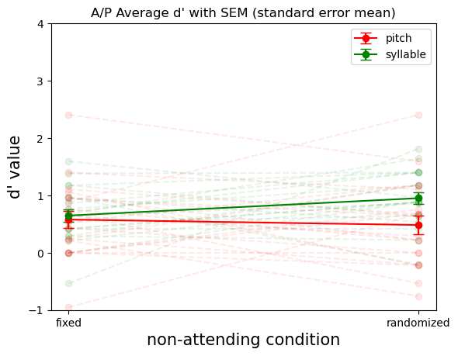
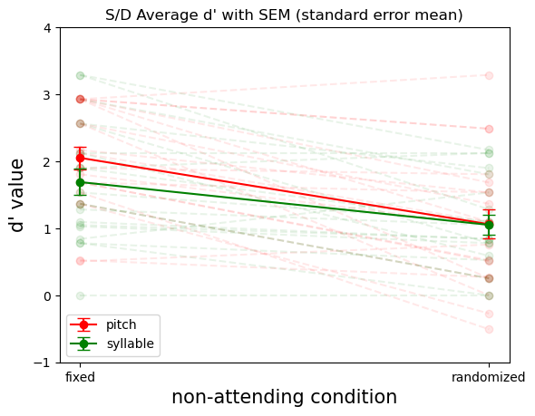
Results for P/A & S/D Tasks - 20 subjects

Slide 4
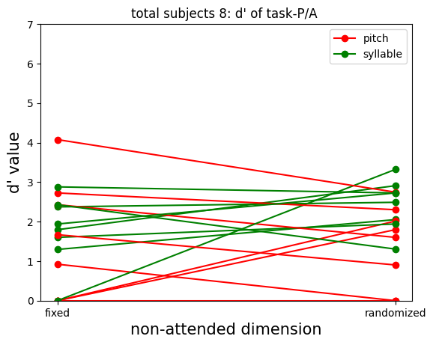
Results for P/A Tasks - 8 subjects
Pitch: ⅝ shows decrease d’
Syllable: no obvious pattern

Slide 5
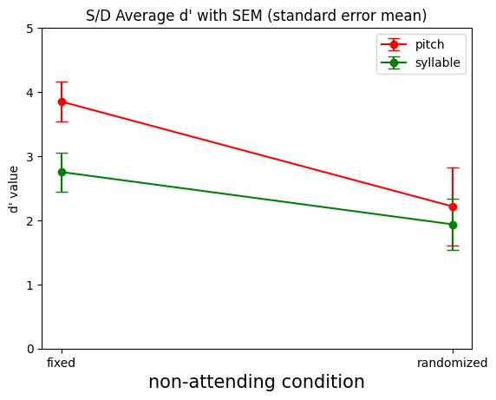
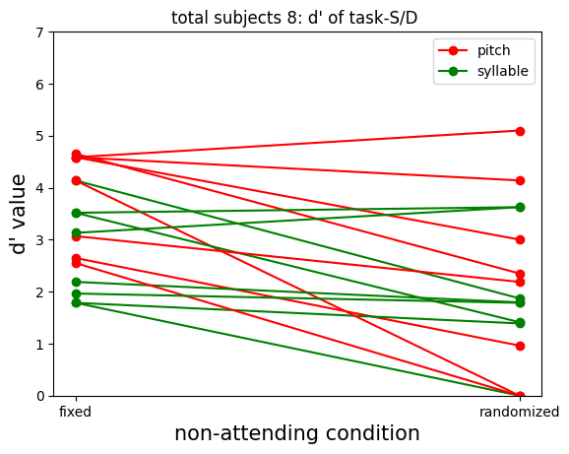
Results for S/D Tasks - 8 subjects

Slide 6
Results for S/D Tasks - 8 subjects
Pitch:
⅞ shows decrease d’
Syllable:
⅝ shows decrease d’

Slide 7
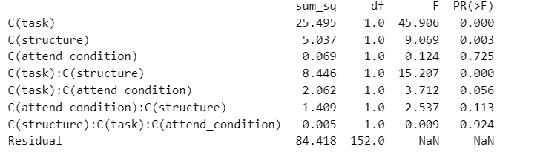
3 way ANOVA Test

Slide 8
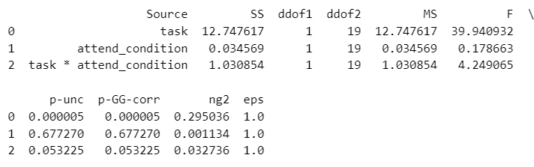
2 * 2 within subject ANOVA( task & attend condition )
Cohen's f
Cohen's f power analysis (0.8 alpha power) on 2 * 2 within subject ANOVA => total 13 subjects
3 way ANOVA => total 323 subjects

Slide 9
Thoughts on Extensions
What are the patterns of brain activation during the working memory task?
What is the temporal dynamics of these activations
Can we predict task performance based on brain activity patterns?
Are there different neural pathways engaged depending on the type of working memory task (e.g., visual versus verbal)?
How does distraction or dual-tasking affect brain activity during a working memory task?

Slide 10
Future
Plans
Notes:
Effect size: This measures the magnitude of the difference or the strength of the relationship between variables. It can be difficult to estimate, especially in complex designs like a 3-way ANOVA. Cohen's f is often used in the context of ANOVA, where 0.1 is considered a small effect, 0.25 a medium effect, and 0.4 a large effect.
Alpha level (α): This is the probability of making a Type I error, which is rejecting the null hypothesis when it is actually true. Commonly, an alpha level of 0.05 is used.
Power (1 - β): This is the probability of correctly rejecting the null hypothesis when it is false. In other words, it's the probability of not making a Type II error. Typically, a power of 0.80 or 0.90 is desired.

